Slide 1
Programme Review Seminar
Thursday 27 April 2017
WELCOME
Notes:
Good morning everyone. My name is Kevin Slade, chairman of the Merchant Navy Training Board. I am pleased to welcome you all here today and it is good to see familiar and new faces from the wide range of company, college and university, Nautilus International, RMT, MCA representation, and the largest number of trainees – rating apprentices and officer cadets that we have ever had. It is very good to see you, we appreciate your attendance and look forward to hearing your views and input into our work from the sessions this afternoon. I hope you find today interesting and useful, and I would like thank your companies and colleges/universities for ensuring such excellent attendance.
Before we start, here are the housekeeping points. We are not expecting a fire alarm test, so if it does go off we need to leave by the nearest exit – as marked, do not use the lifts, and on leaving the building we will collect in the square across the road from the main entrance.
Toilet facilities are back through reception and off from the lift lobby.
You have been provided with the programme for the day and the attendee list. It is a very full programme and we need to make sure we stick to the timings, in order to fit everything in. And with such full attendance, space will also be a bit tight for the workshops, so please bear with us on this and let’s get started.

Slide 2
Purpose of the Day
The purpose of the day is to:
give an overview of MNTB new entrant seafarer programmes and related aspects;
provide the picture of new entrant seafarer training provision and availability;
provide an MCA update on written and oral examinations and TRB completion;
provide the opportunity to discuss and provide feedback on a range of training aspects, including SMarT Plus, training berths, industrial experience for engineers, Training Record Book management, use and updating requirements
Notes:
As you can see, the purpose of today is to:
give an overview of MNTB new entrant seafarer programmes and related aspects;
provide the picture of new entrant seafarer training provision and availability;
provide an MCA update on written and oral examinations and TRB completion
provide the opportunity to discuss and provide feedback on a range of training aspects, including SMarT Plus, training berths, industrial experience for engineers, Training Record Book management, use and updating requirements
The format of the day, as you can see from your programme is for MNTB and MCA update presentations to start. We then have a very busy session with colleges, universities and a training centre providing us with the full picture of new entrant rating apprenticeship and officer cadet education and training provision across the UK. We feel we are reaching a fairly seminal time in the industry with regard to new government policy, industry requirements, MNTB, Chamber and our social partners ambition for increased numbers of UK seafarers and a resurgence in their employment, training, development and career opportunities. We also have the new MNTB Training Standards and apprenticeship programmes, some still under development, and to have that good understanding of training provision and intake figures, along with company aspirations, is important for us all.
Following lunch, we will have 6 workshop groups, each looking at specific aspects of training, and with the feedback and plenary session, we aim to finish at 1500.
I’d now like to ask Glenys Jackson, MNTB Director, to provide her update on officer cadet education and training. Glenys ………….

Slide 3
Officer Cadet Training Update
Annual officer cadet intake programme statistics
SMarT Plus Strategy
Training berths
Industrial experience for engineer officer cadets
Training record book update
Notes:
Good morning everyone. As Kevin has said, it is very good to see so many of you and such a full room.
I am covering the usual annual cadet intake statistics; where things are at with the SMarT Plus strategy; work we are doing on training berths; looking at industrial experience for engineer officer cadets and our current training record book update work.

Slide 4
Officer Cadet Training Programmes
Full year | FD/SPD (deck, eng & ETO) | HNC/HND (deck, eng ) | Other degree (deck, eng) | Totals (deck, eng & ETO
2016/17 | 386 (168, 181, 37) | 359 (135, 170)* (22, 32)** = HNC+ HND top-up ** = HND only | 26 (13, 13) | 771 (338, 396, 37)
2015/16 | 395 (190, 175, 30) | 367 (192, 175) | 15 (8,7) | 781 (392, 359, 30) includes 4 experienced seafarers
2014/15 | 409 (209, 157, 43) | 408 (199*, 202**, 7) | 10 (4, 6) | 827 (408, 359, 50)
2013/14 | 374 (178, 164, 32) | 404 (203*, 199**, 2) | 3 (1, 2) | 781 (382, 365, 34)
Notes:
The annual officer cadet intake has been reported as 771 by sponsoring companies and training management organisations, 10 less than the previous year. Interestingly, the number of engineers has increased by almost 40, and the ETO numbers have also increased, whilst there has been a reduction of 54 deck cadets.
As part of our SMarT Plus strategy, we are looking to increase the cadet numbers entering annually by some 400 to 1,200 by 2020 – a 50% increase. This is not impossible, and we had a larger percentage increase from the late 1990s over the following 10 years, from around 400 cadets entering at that time to reach almost 1,000 around 2010.

Slide 5
SMarT Plus Strategy
SMarT Plus – a higher level of SMarT funding in return for a guarantee of a minimum 12 months employment post certification Existing SMarT to continue for companies that do not guarantee post certification employment
Strategy received favourable response from government, now need to determine specific policy aspects and how it could best work in practice

Slide 6
Training berths
Ensuring availability of sufficient berths of suitable quality:
the proposal for a dedicated training platform through utilisation of an existing vessel;
to liaise with the RFA about potential time charter arrangements of an RFA vessel with a suitable readiness profile as a ‘training ship/platform’;
to work with specific ferry companies that would be prepared to make spare out-of-season berths available for training berth purposes;
the proposal for a new Royal Yacht (as an ‘exhibition ship’) to replace Britannia, with utilisation of berths for officer cadet and rating apprenticeship training;
to identify other opportunities to ensure sufficient and suitable training berths
Notes:
We also feel that the move of our cadet training frameworks to training standards will provide greater flexibility for colleges and universities to better manage programme phases across disciplines and programmes, helping companies to utilise their sea berths more efficiently and effectively.

Slide 7
Industrial Experience for Engineer Officer Cadets
The need for 12 months sea time and workshop skills/industrial experience
issues in achieving the 12 months sea time and workshop skills/industrial experience;
existing/new/innovative ways that are already in place to achieve the above;
the potential for utilising the RN work placements at Portsmouth and Devonport (Plymouth) dockyards.

Slide 8
Training Record Book Update
Due for updating
format and layout of the TRB
guidance pages;
specific tasks;
workbook guidance/examples;
e-learning acticities
Points of good practice in TRB management and explanation for companies and colleges
Notes:
Thank you for listening. We will be covering these aspects in our workshops this afternoon.
Kevin – Thank you Glenys. I now have the pleasure of introducing out new MNTB Training Development Manager, Mark Burgess, who is covering the rating training, apprenticeship and employment work. Mark has been with us just over two months and is quickly getting to grips with the industry, from his background in managing a large and varied range of apprenticeship training programmes with Tower Hamlets. Mark ……..

Slide 9
Ratings Task Force, Ratings Training and Apprenticeship Strategy
Mark Burgess
Training Development Manager
Notes:
The ratings task force exists to improve the prospects for UK ratings and to gain an accurate picture of employer activity in terms of recruitment. The apprenticeship strategy is a concerted approach to make sure that apprenticeship programmes are of good quality and relevant to the industry and that these programmes develop a good reputation to increase their take-up

Slide 10
Ratings Task Force
Challenges of the British Rating Workforce
Ratings Strategy
Employer Engagement
Website Pages
Funding Guidance
Notes:
RTF is working to improve the prospects of UK ratings in terms of training and employability. To this end the RTF needs to cover the whole process from good recruitment through to improved prospects via clear funding opportunities and a structured training programme that enables UK ratings to receive high quality training and apply that training in their workplace. Part of the Ratings strategy is the promotion of apprrenticeships but not exclusively.

Slide 11
Apprenticeship Strategy
Apprenticeships Standards and frameworks
Able Seafarer (Deck)
Able Seafarer (Engine)
These standards and the existing able seafarer (engine) have been written, approved and are being delivered in the workplace.
Notes:
Developing standards means decision by employers with input from trade associations, qualification bodies and government.

Slide 12
Apprenticeship Strategy
Maritime Trailblazer Group
Developing standards and assessment plans.
Promoting these to the wider workforce
Projections around take-up of the standards
Projections around costs
Notes:
The Group meets regularly and covers all aspects of employment and development within the shipping industry. It liaises with government most notably through the Institute for Apprenticeships. Most importantly it needs to cover a number of progressive stages through the development of training standards, the promotion of training standards and an increased confidence and certainty around costs and quality standards.

Slide 13
Apprenticeship Strategy
Apprenticeship Levy Guidance
Registration
Digital Vouchers
College and Employer relationship
Notes:
The Levy came into force on 6th April and first payments will be coming through at the end of May. There are a number of different areas where support may be needed but the most likely ones will be around registration and the use of digital vouchers as well the developing relationships between employers and providers. In some ways the Maritime industry may have some advantages here because colleges and employers are already well known to each other.

Slide 14
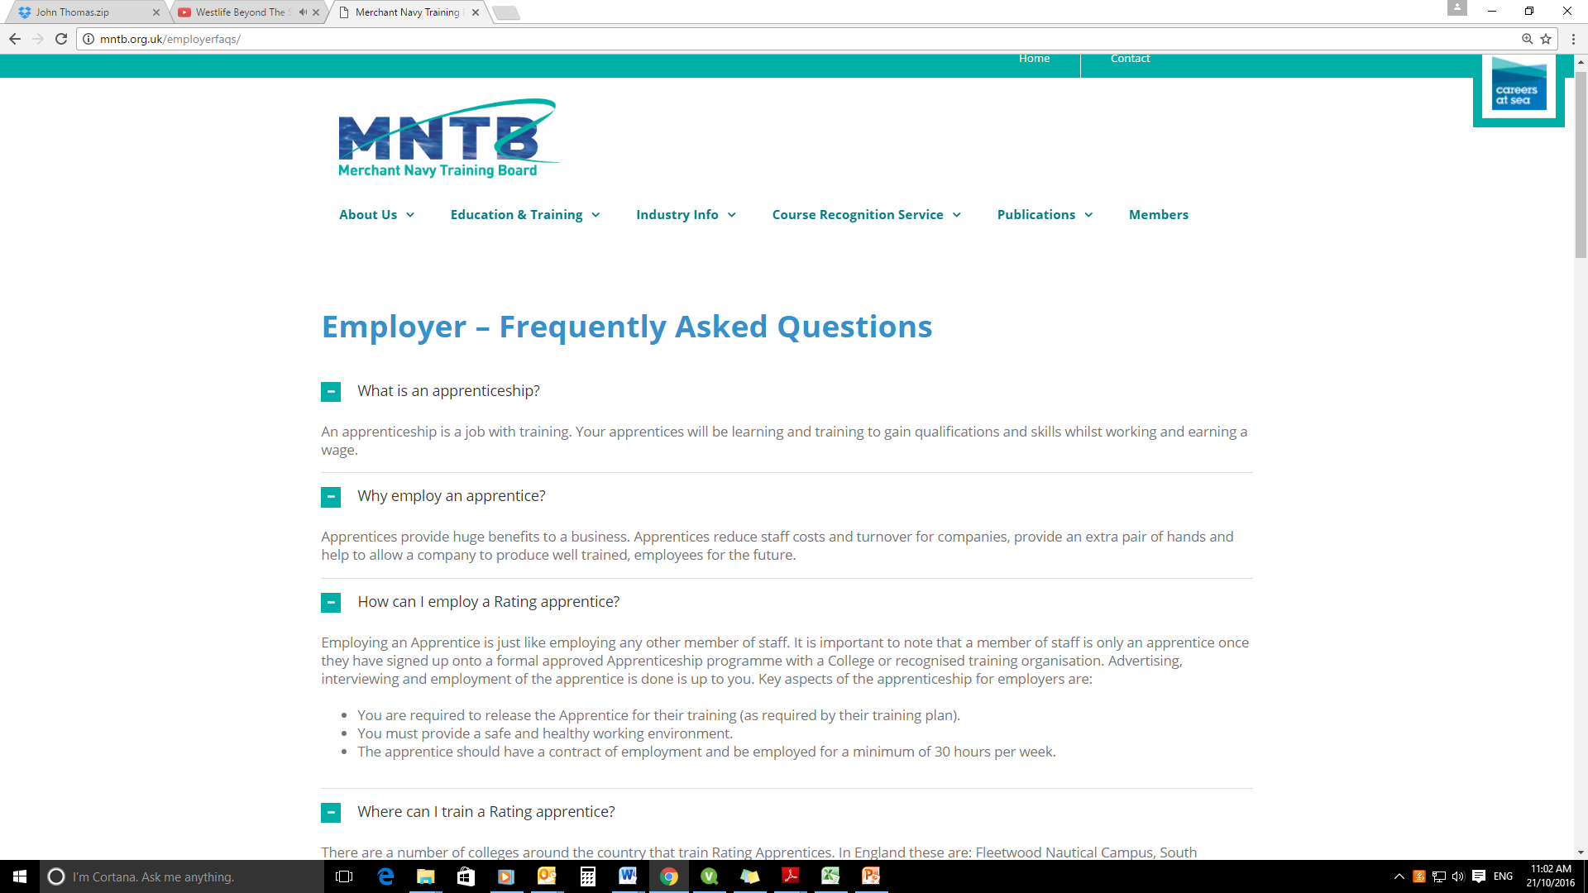
MNTB - Ratings Pages

Slide 15
Other Pages
Careers at Sea – Case studies across the industry
Maritime Skills Alliance (MSA) – Units and Pathways
Maritime Educational Foundation (MEF) - Bursaries
Notes:
Careers at Sea works to promote seafaring through individual experience both in terms of the personal accounts and in terms of the ambassador programme where seafarers of different ranks and experience can inform schools, colleges and other organisations about their own experience and how best to shape one’s own approach to a career in the Maritime industry. The MSA is developing and promoting specific training solutions for specific careers paths. The MEF provides funding support for employers and individual seafarers to promote a well trained workforce (to employers) and improved prospects through the updating of qualifications (for individual seafarers). There is also a provision for special projects whose aim is to increase the knowledge, awareness and learning of maritime skills.

Slide 16
Rating Apprenticeship Training Programmes
Full year | Deck | Engine | Other | Projected | Total
2016/17 | 78 | 43 | 70 | 22 | 213
Notes:
On completion of the presentation, Kevin Slade will say ….Thank you Mark, we look forward to hearing about further ratings development in the coming months. I’d now like to hand over to the MCA for their presentation. We are very pleased to have with us a full MCA team – Iftekar Ahmed –engineer examiner, Delowar Hossain and Reza Nosrati, both deck examiners. Delowar, I believe you are providing the presentation. Over to you.
Thank you Delowar – some useful food for thought there.
And now it’s the start of our sessions on new entrant training provision. Not all of the colleges can be here, and Glenys will present on behalf of the four that are missing – Shetland School of Nautical Studies, Scottish Maritime Academy at North East Scotland College in Peterhead, Orkney College and North Kent College. Over to you Glenys. Thank you.

